Slide 1
Bootstrap vs foundation
qINLAN ZHAO (QZ25) 04/18/2017

Slide 2

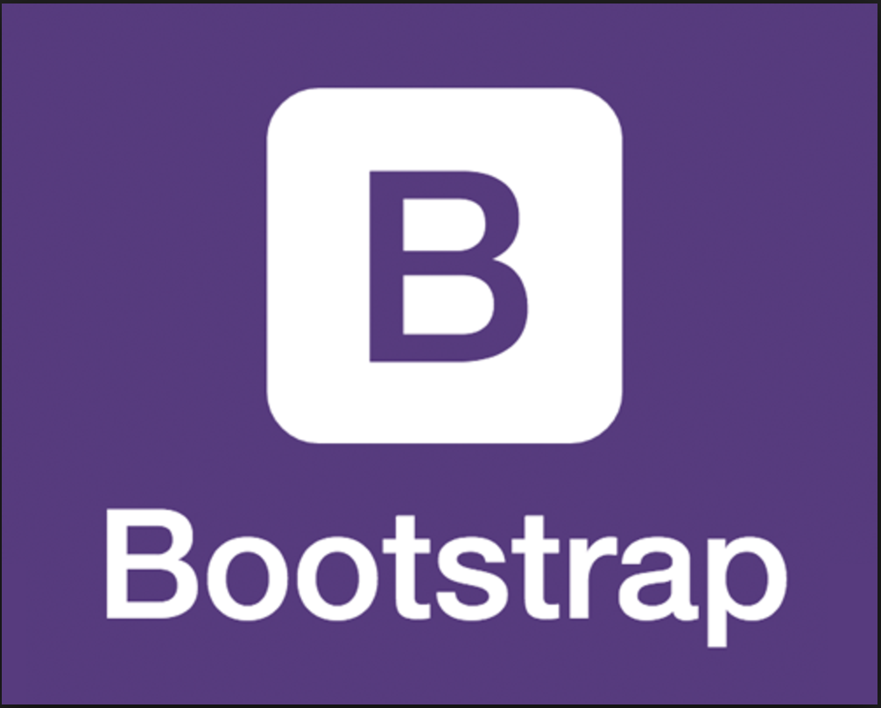
vs
Bootstrap is developed by Twitter and released its first version in 2011.
Foundation is built by ZURB, a product design company. And it was also released in 2011.

Slide 3
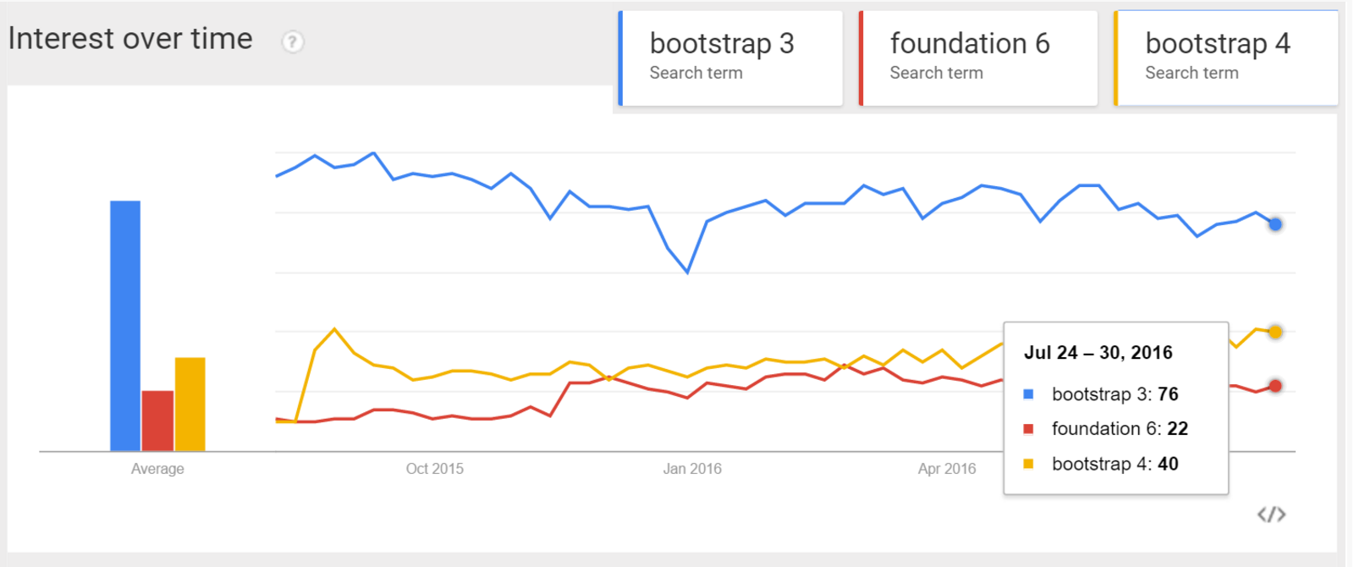

Slide 4
1 CSS preprocessor:
Both Bootstrap4 and Foundation6 now consist mainly of SASS CSS preprocessor.
What is CSS Preprocessor??

Slide 5
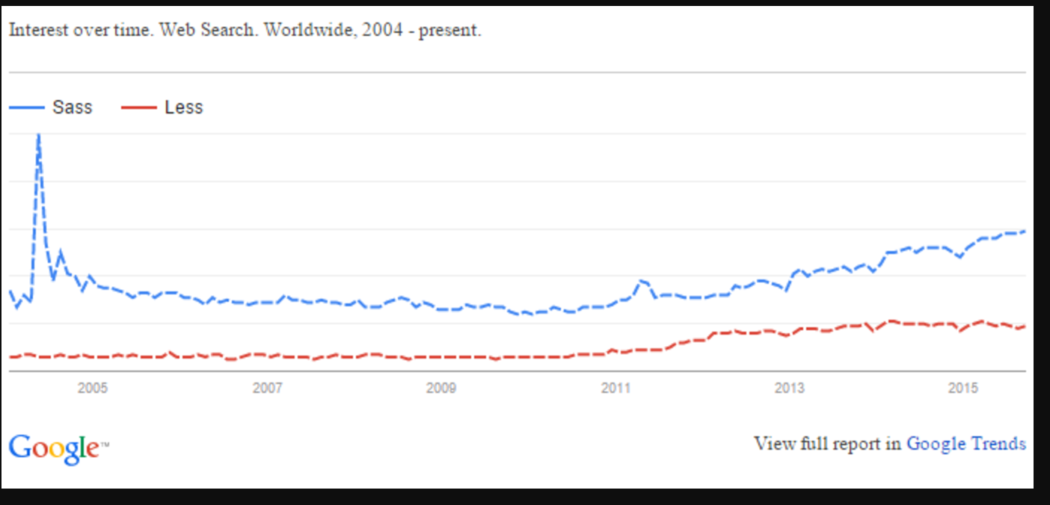
Sass is more popular

Slide 6
2 Grid
Both Bootstrap4 and Foundation6 support up to 12 columns with fluid widths up to 75em.
Why is 12 Columns??
Notes:
12 can divided by 1,2,3,4,6. So we can use it to build 12,6,4,3,2 colums in our website!

Slide 7
Foundation perform better, WHY?
  Foundation has no containers and relies heavily on rows
  Foundation has support for responsive gutters
  Foundation has support for having or removing gutters in specific cases

Slide 8
3 MENUES
Bootstrap4 has the same old dropdowns, tabs and basic navigation menus
Foundation6 has dramatically improved it with more stuff.

Slide 9
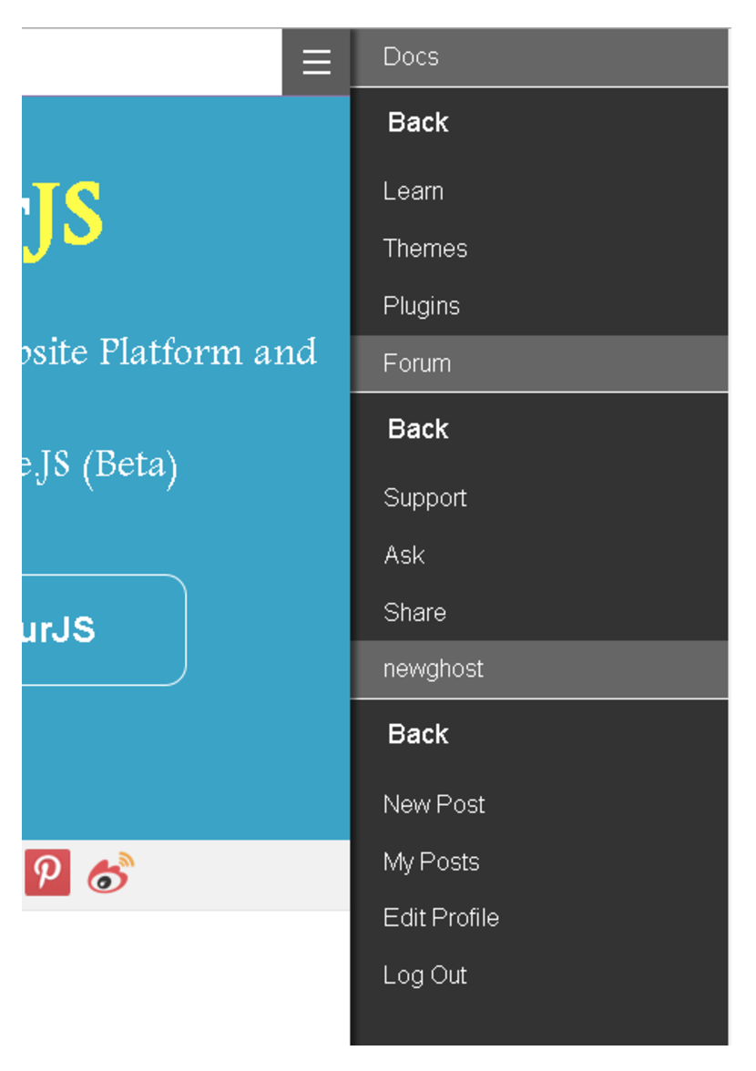
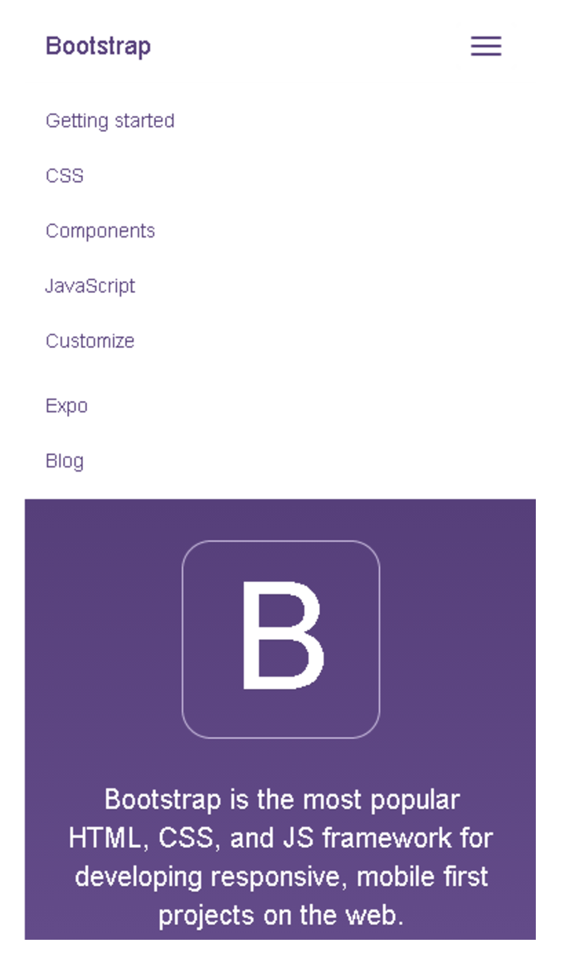
menu: off-canvas navigation

Slide 10
4 Compatibility
Foundation6 works better in both pc and mobile!
  Foundation uses mobile-first approach for design.

Slide 11
Conclusion
Foundation6 has slightly more powerful grid system
Many popular thoughts were given by foundation. However, Bootstrap4 is a quick learner.
Bootstrap4 is more suitable for building a quick site without much customization

Slide 12
Thank you！

